Slide 1
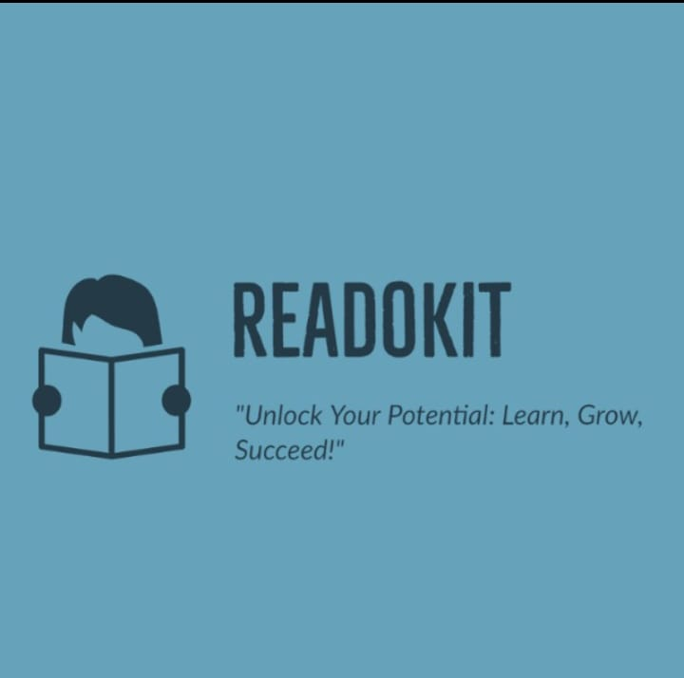
“Unlock Your Potential: Learn, Grow, Succeed!”
Title: Readokit

Slide 2
Introduction :
The proposed project is an online educational platform that uses animation as a medium for delivering engaging and effective educational content.
The platform will have an easy-to-use interface, making it accessible to learners and educators of all technical abilities.

Slide 3
Benefits of E-learning and Animation:
E-learning provides learners with convenient access to educational resources and courses, eliminating geographical barriers.
This accessibility allows individuals to learn at their own pace and from any location, fostering a flexible and personalized learning environment.
When combined with animated videos, the benefits are further amplified. Animated videos captivate learners' attention through visually appealing graphics, dynamic animations, and colorful visuals.

Slide 4
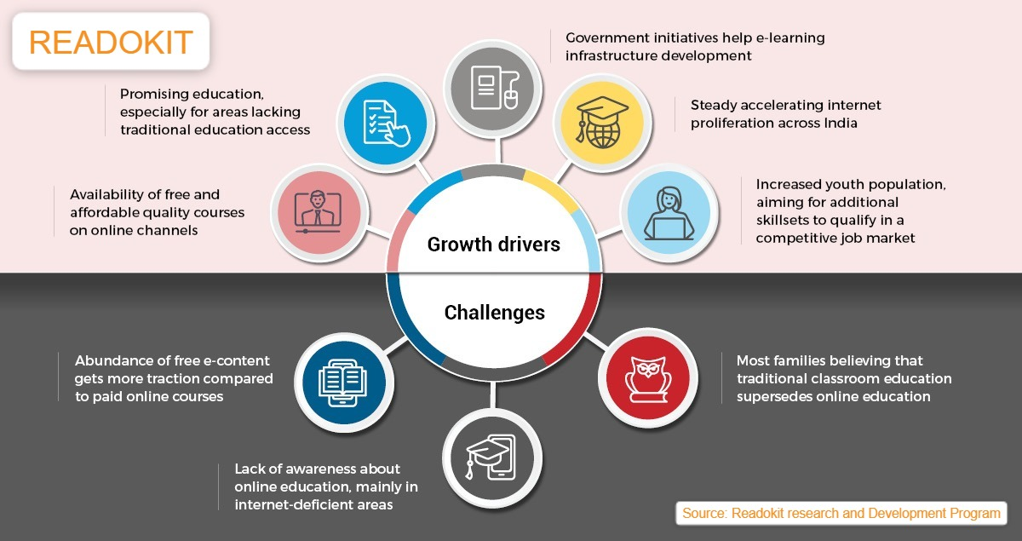

Slide 5
Features of the E-Learning Website:
Interactive animations and visuals.
User-friendly interface.
Comprehensive coverage of NCERT
curriculum.
Personalized learning options.
Responsive design that ensures the website is accessible and functional on different devices, including smartphones and tablets.

Slide 6
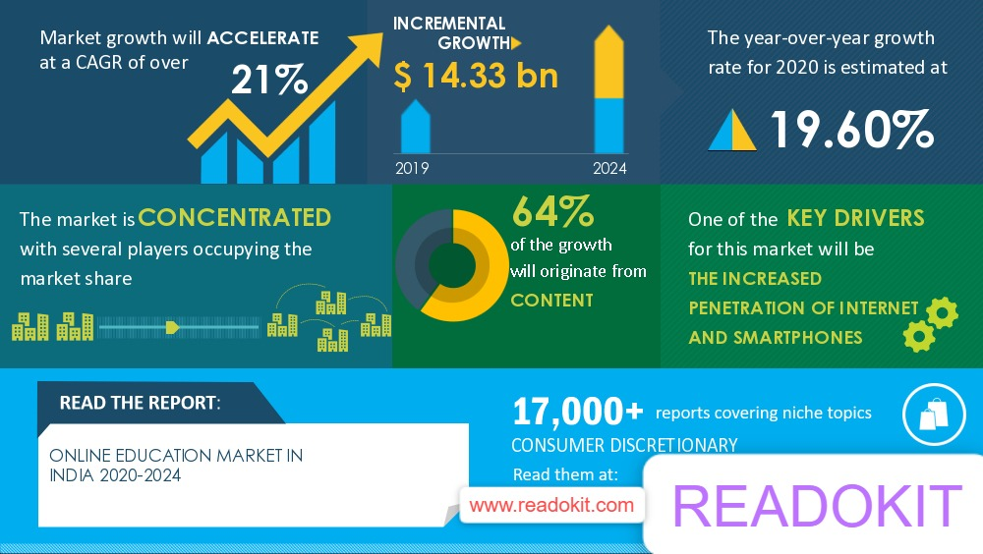

Business Report

Slide 7
Subject-wise Content:
The concept of providing subject-wise content involves delivering comprehensive educational materials and resources for each specific subject or discipline.
It aims to provide learners with a structured and organized approach to acquiring knowledge and skills in various academic areas.
It follows a curriculum or syllabus framework, aligning with educational standards and guidelines.

Slide 8
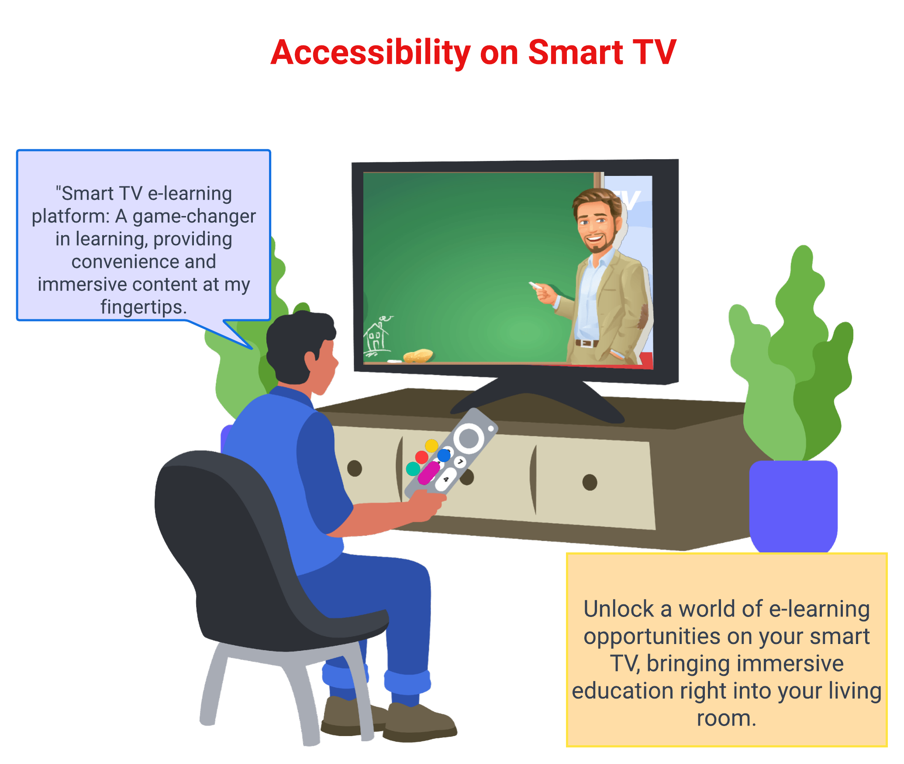

Slide 9
Requirement:
Programming Languages:
HTML5: For creating the structure and content of web pages.
CSS3: For styling and layout of the web pages.
JavaScript: For adding interactivity and dynamic functionality to the platform.
Web Development Frameworks:
ReactJS or Angular: These frameworks can be used for building the frontend of the website or web application.
Node.js: A JavaScript runtime environment that can be used for server-side development and handling backend functionalities.
Animation and Graphics:
Animation Software: Tools like Blender, Adobe Animate or Toon Boom

Slide 10
Real-Time Performance Tracking:
Real-Time Performance Tracking refers to the ability to monitor and assess learners' progress, achievements, and performance in real time during their e-learning journey.
It involves the collection, analysis, and presentation of data related to learners' activities, interactions, and outcomes within the e-learning platform.

Slide 11
Case Studies: Animation Videos in Education.
Several studies have shown the effectiveness of animation videos in education.
For example, a study conducted by the University of California, Berkeley found that students who watched an animation video on a complex scientific concept performed better on a test than those who received traditional lectures. Similarly, a study conducted by the University of Texas found that animation videos improved student engagement and retention of information.

Slide 12
Profile and privacy User-friendliness Nowadays the cyber security on the website and apps are becoming major issues which is by taking too much information from the user in this site we will try to minimize the information taken from the user so that we can maintain user privacy. If any condition of cross site scripting occurs the user vital information cannot be steal through any fake website or redirecting which we help ensuring cyber security of user initially

Slide 13
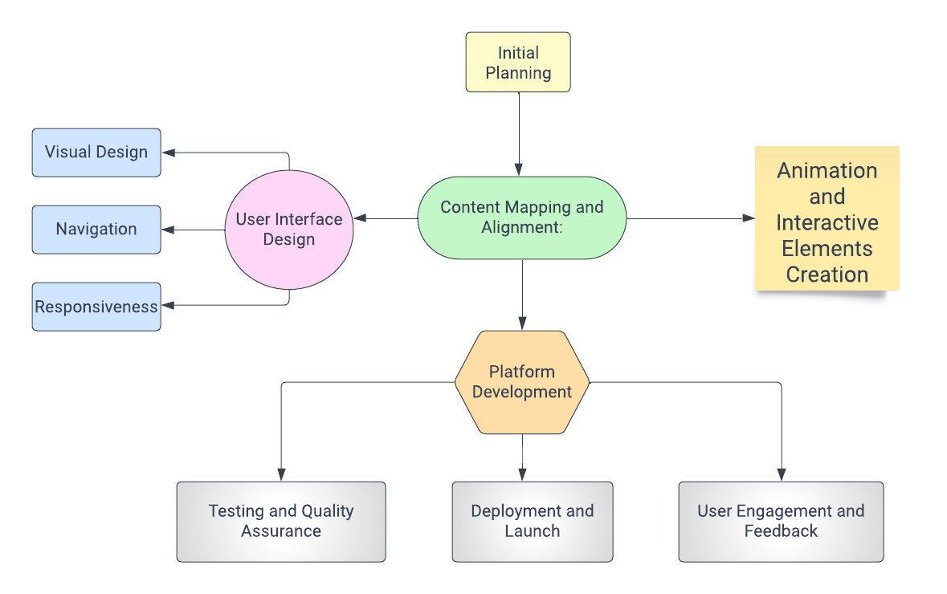
Workflow Process Chart

Slide 14
Drawbacks and approaches to solve it in future The problem which will arrive on this site will be traffic retention because of many site has already have this idea on their site with high traffic but to solve this problem we will apply artificial intelligence in the site which will be applied in form of quiz and according to the quiz the algorithm will give them suggestion on the books and notes to their website so that the person who is using the website can get books easily and the platform becomes more user-friendly.

Slide 15
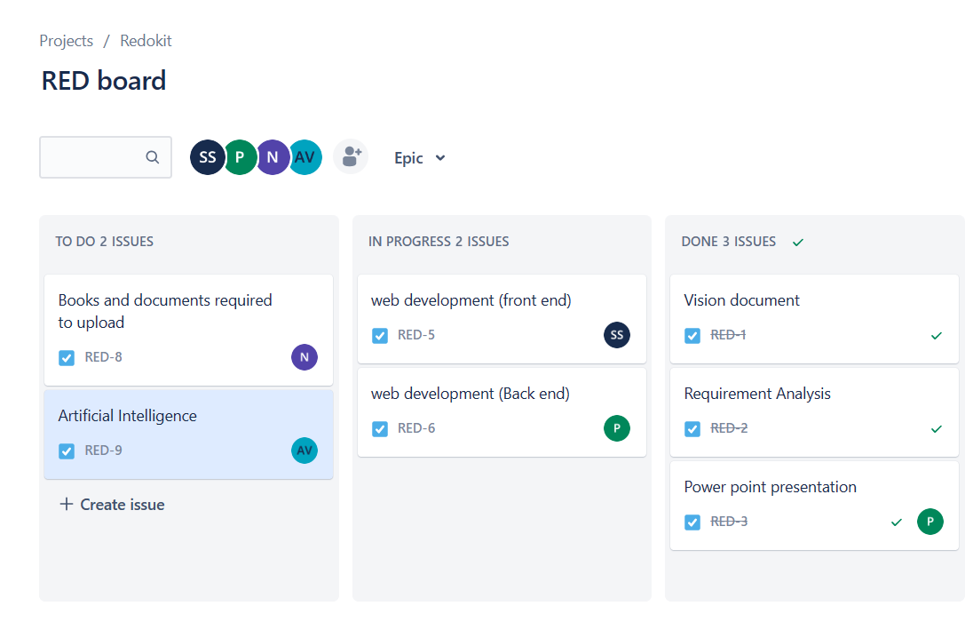
Workflow division –JIRA software
Our workflow management is done through jira for managing the progress and analyzing the requirement of the resources through this application it is helpful in easily managing the work flow of the project.
It also provides us the analytics of work progress and which work to focus on this software provide us the mapping of the work on which we have to work and we can prepare our plan of the project and divide work accordingly.
This software help us managing project more efficiently and in well planned manner .

Slide 16
Conclusion:
In conclusion, the e-learning website with animated content based on the NCERT curriculum offers numerous benefits and advantages for learners.
E-learning has revolutionized the education landscape, providing learners with flexibility, accessibility, and convenience. It enables learners to access educational materials anytime, anywhere, and at their own pace.
It bridges the gap between traditional classroom learning and the evolving needs of learners in the 21st century, ensuring an engaging and enriching educational experience for all.

Slide 17
Feedback and recommendation As we progress in this project and built the site we will feedback forms to fill in by the people using it , it will help us get outer prospective on what to improve and add on to the site which will make the site more and more user friendly their will be feedback menu available on the site to for getting reviews and constructive criticism which will give us more and more clarity on what we have to improve. Thus as we are presenting this website we will like to get more and recommendation from everyone to built this website more and more efficiently.

Slide 18
References 1.Wikipedia -Education – Wikipedia 2. Cadabra -How to Design an Educational Website [with Examples] - Cadabra Studio 3.UNESCO -Artificial intelligence in education | UNESCO

